Slide 1

FINAL PROJECT 2 EDA & Visualization DS102
NAME: WONG WOON YONG
STUDENT No.: ML2020044

Slide 2
Overview
This presentation is an analysis of a World University Ranking report for year 2012 to 2015.
The discussion is divided into Question A, B and C.
Question A, observation on problems in the report and possible solutions to overcome it. Perform basic statistics study on the variables.
Results to answer Question B, total 6 questions.
Question C, discussion on factors or research criteria that support this report.

Slide 3
Question A
Observation:
After inspect and found the data is having problem on different sample size, where first 2 years is Top 100, and another 2 years is Top 1000.
This will affect accuracy of the analysis, because ranking of university will change every year.
In order to overcome this, the data will be evaluated by sorting into two data frames, Top 100 (df_T100) for year 2012 and 2013, and Top 1000 (df_T1000) for year 2014 and 2015.

Slide 4
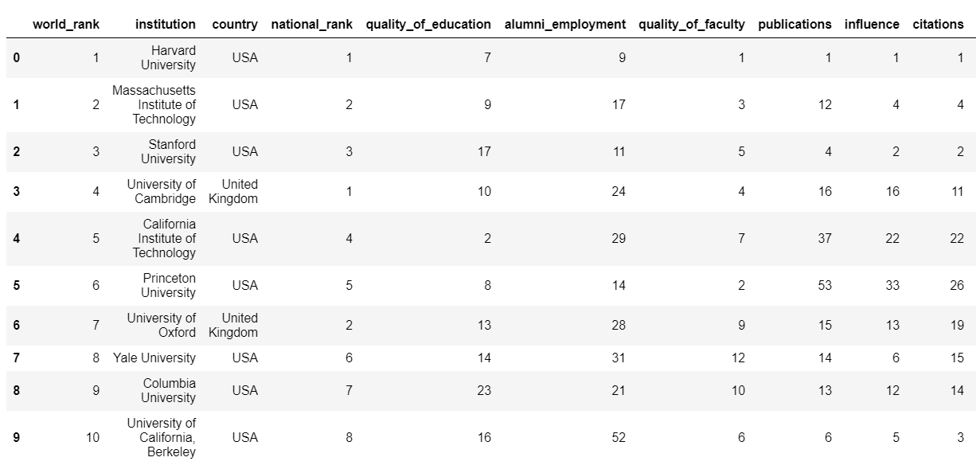
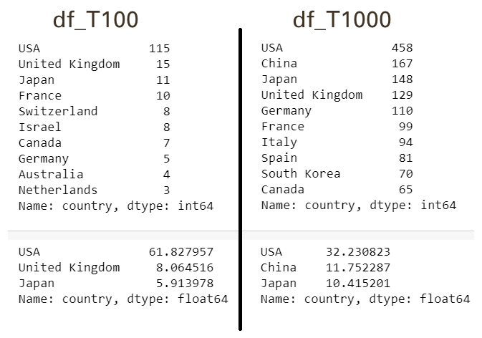
Question A
Table showing the result by selecting Top 100 data for the first 2 years and statistic result showing the country with maximum and both are USA.

Slide 5
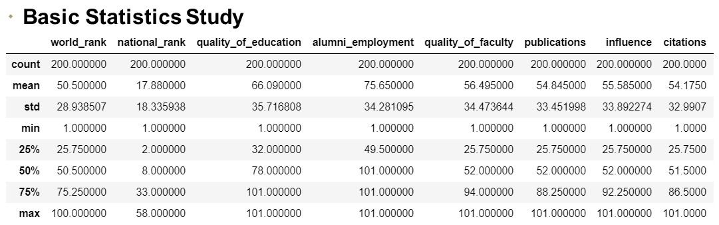
Question A
Table showing the result of Basic Statistics Study for all the other variables.
Note: Alternative solution, data can be sort and focus on Top 100 for 4 years, as the data is equal and sufficient to show the trend of the ranking. These will be evaluated in Question B.

Slide 6
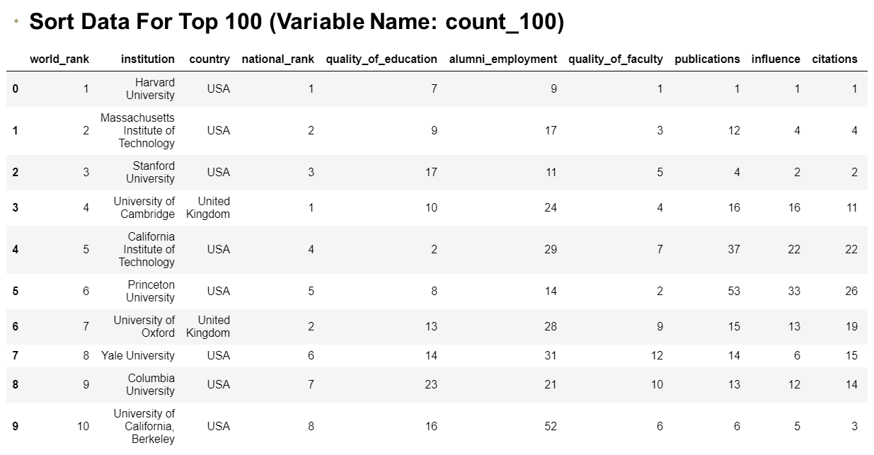
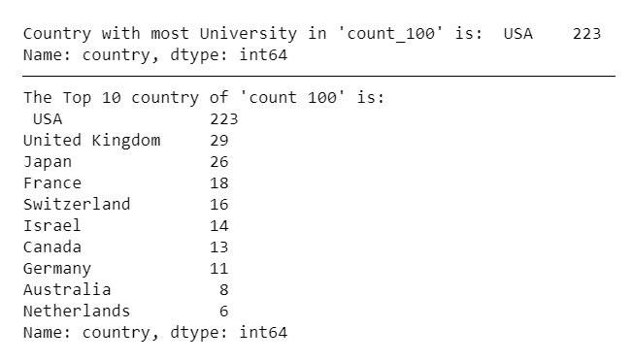
Question B
B1) Will focus on Top 100 for 4 years. Table showing the sorted Data of Top 100 with variable name “count_100” and result of Top 10 country.

Slide 7
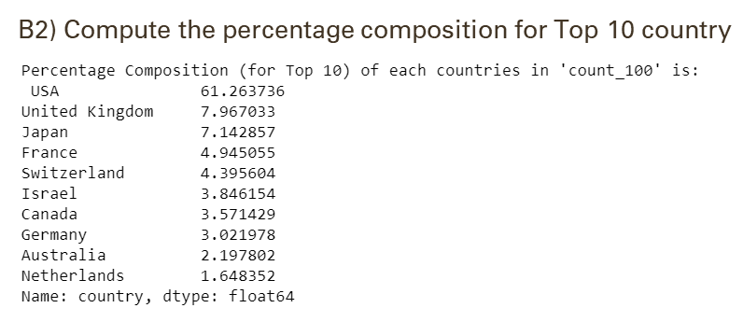
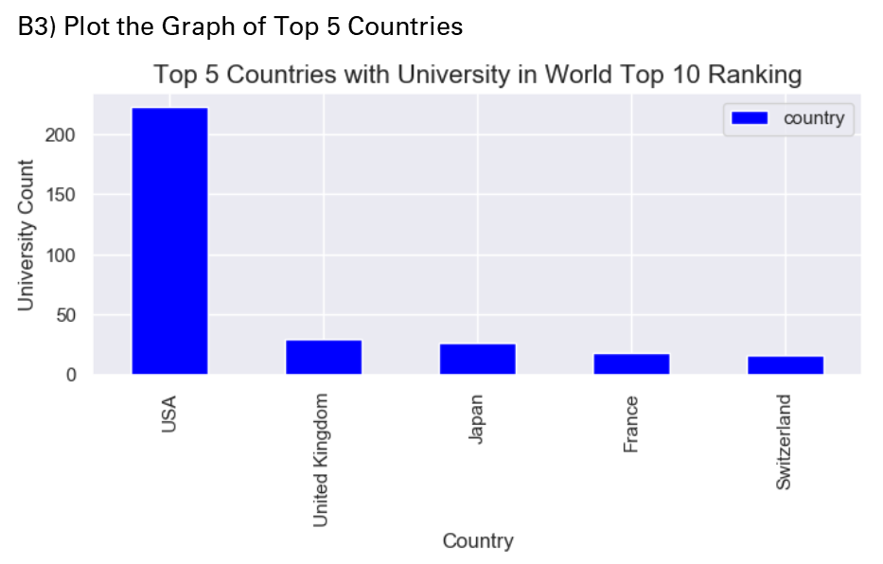
Question B

Slide 8
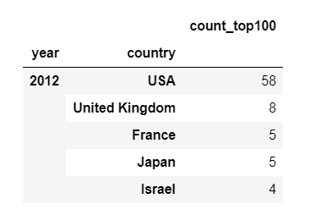
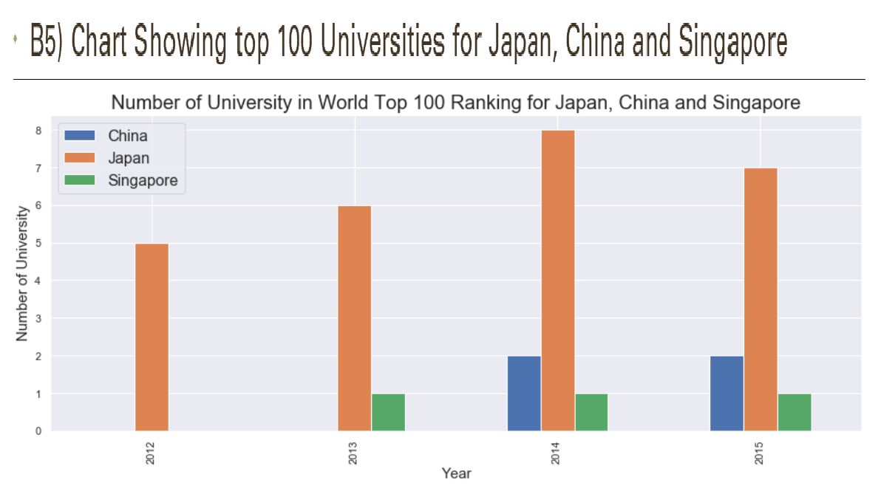
Question B
B4) Applying “Groupby” method and sort the data to show as per table.

Slide 9
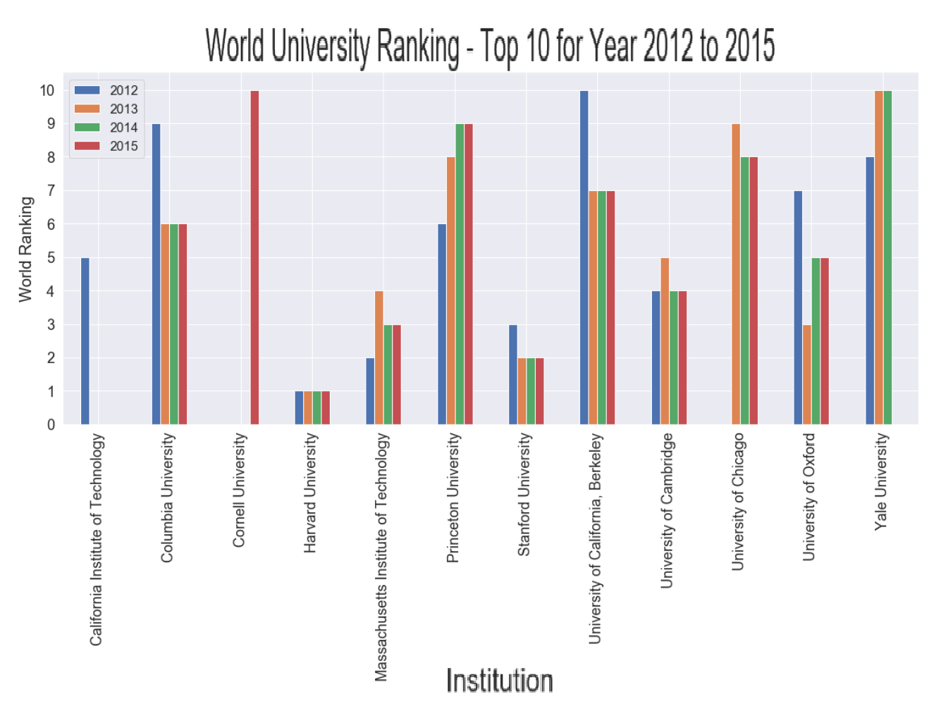
Question B
B6) Increase and declined trends for Top 10 University across the years till 2015.

Slide 10
Question C – Option 2
→ Reference to analysis on Question B, focusing on Top 100 is more accurate. As all 4 years is having equal data and sufficient to show the trend of ranking.
Explanation:
Based on research of this report, factors to be discuss are those with high sampling weighted, the "alumni_employment" (25%), "quality_of_education" (25%), "quality_of_faculty" (10%) and "score" that created based on all the criteria.
The “alumni employment” is measured by the number of a university's alumni who have held CEO positions at multinational companies, “quality of education” is measured by the number of garnered major international accolades and “quality of faculty” is measured by the number of faculty who have won major international awards.
These are the factors that highly impact to the success of the graduate and also the university ranking.

Slide 11
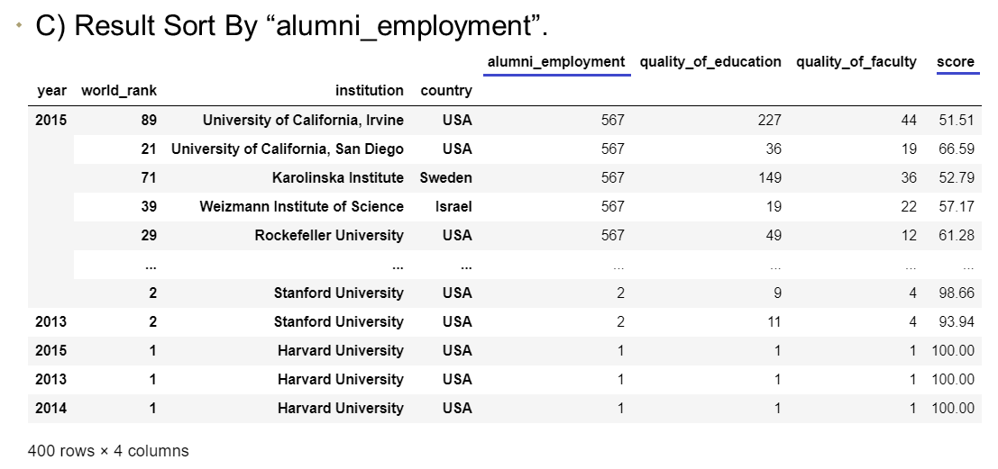
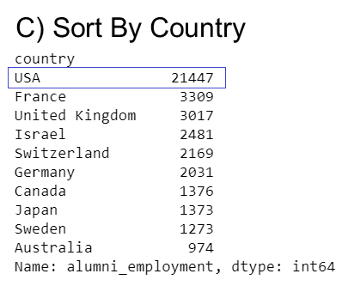
Question C – Option 2
Observation:
University with highest in the factor “alumni_employment”, “quality_of_education” and “quality_of_faculty” does not have the highest in score and world ranking. The score of these university is around 50-plus.
However, if checking based on the individual country, USA still the highest in total results.

Slide 12
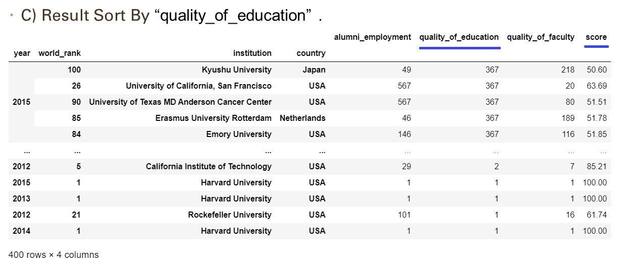
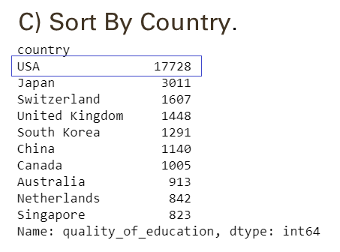
Question C – Option 2

Slide 13
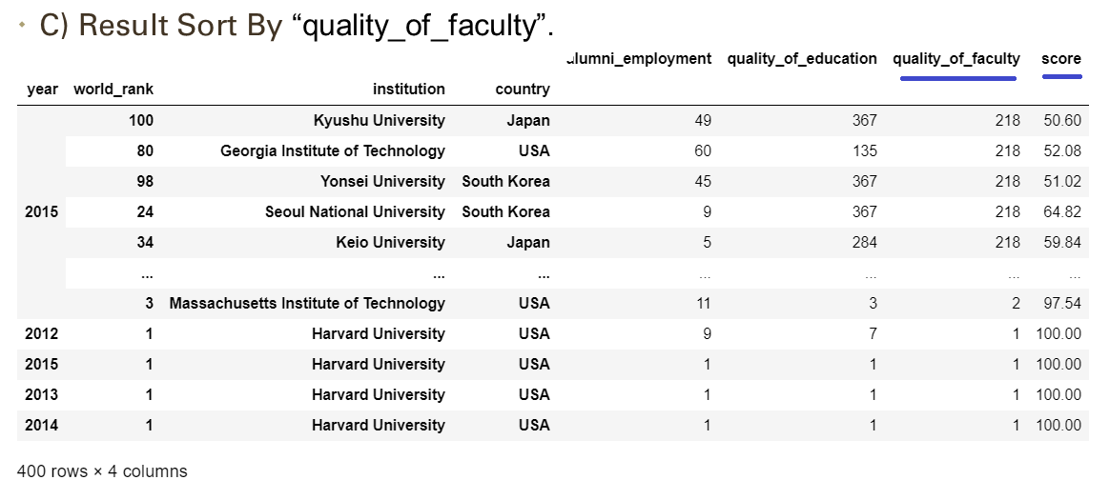
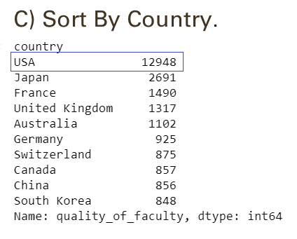
Question C – Option 2

Slide 14
Q & A
- End -

